Slide 1


Renegades Soccer Club
CORE Registration

Slide 2

Thank you Renegades Family! We are glad you are continuing your development with Renegades SC through our CORE Program.
Please follow the instructions below to secure a spot on your team’s CORE Schedule OR with a non-team group.
Step 1. Navigate to the Renegades Soccer Club Website www.renegadessoccer.com and Select “Register Now”

Slide 3
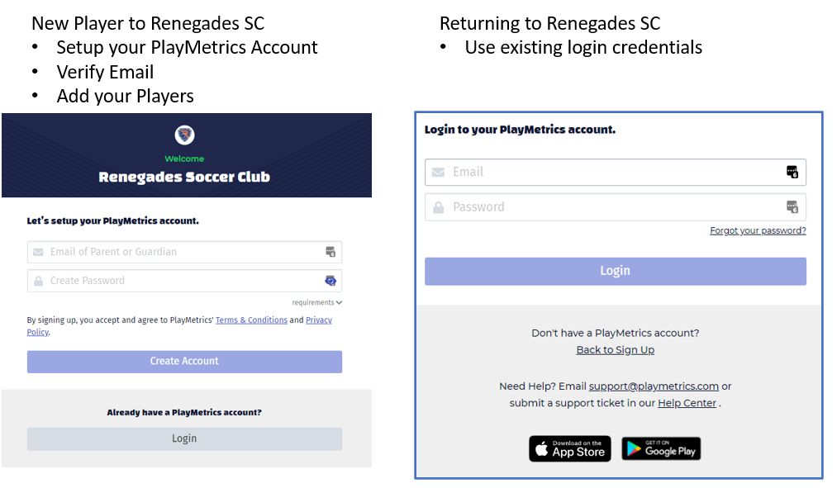
Step 2. Register or log in to the PlayMetrics portal

Slide 4
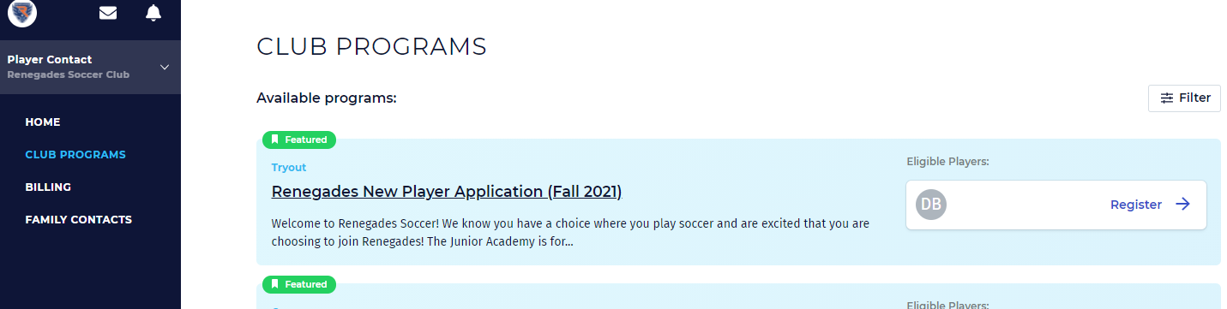
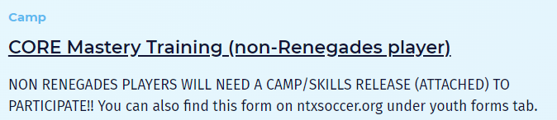
Step 3. Click on Club Programs
Step 4. You will see the CORE Mastery Training Program. You should also see the initials of your player as an Eligible Player. Click on the Register Button for applicable program.

Slide 5
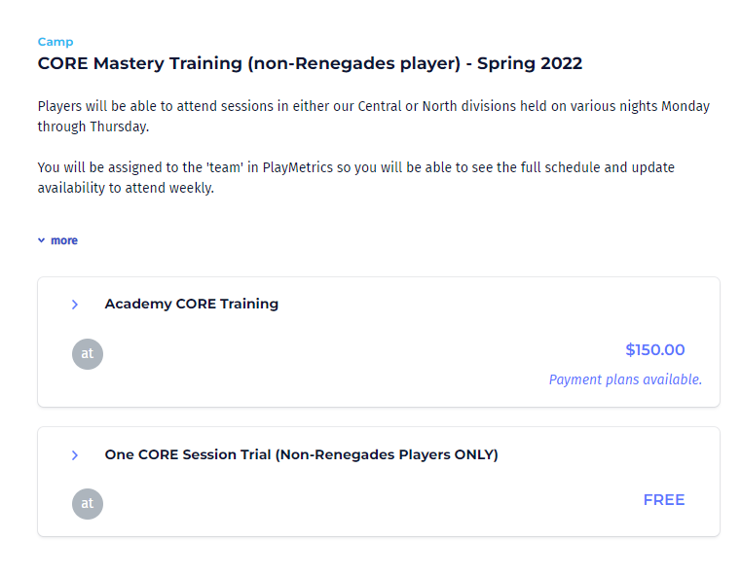
Step 6. Click the box One CORE Session Trial.

Slide 6
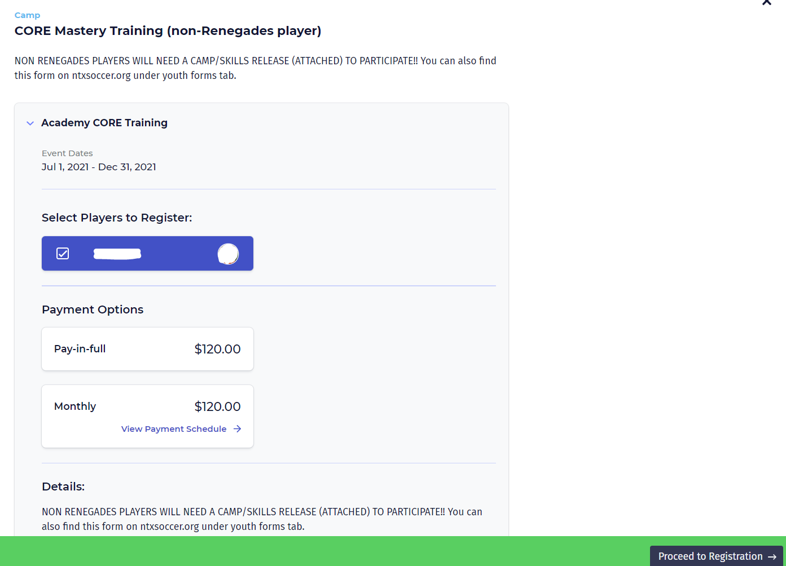
Step 6. Proceed through the registration steps. Click the box with the player’s name and click on Proceed to Registration to continue.
(This screenshot shows the player selected, the payment plan options and details of the program. )

Slide 7
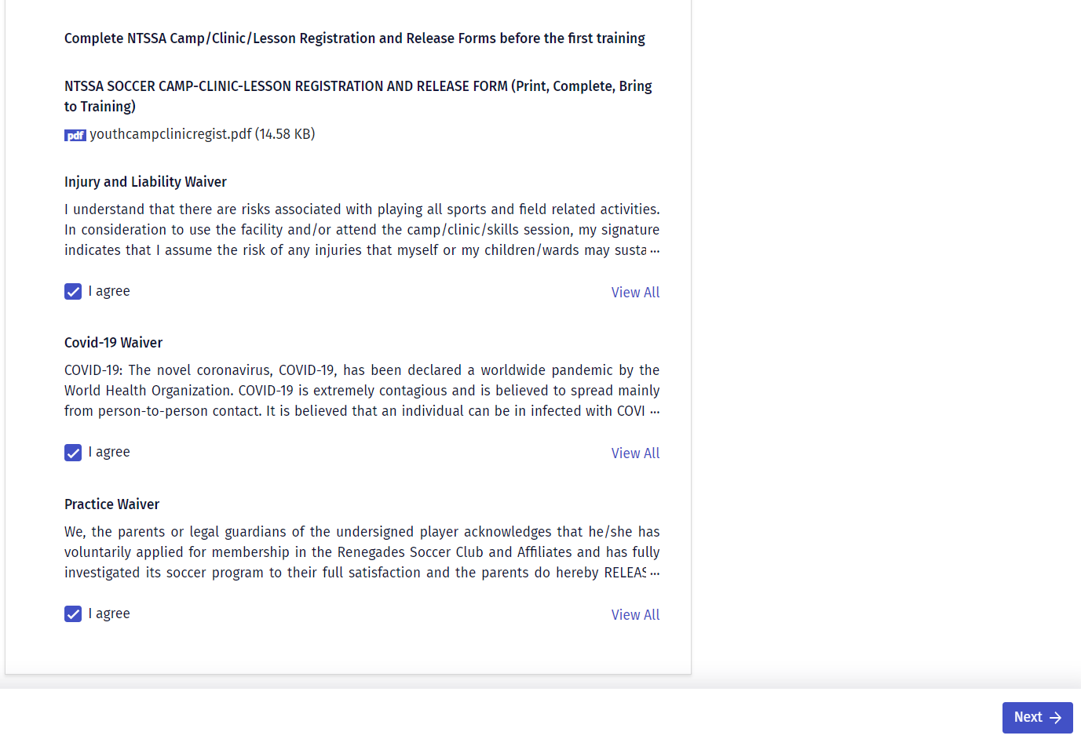
Step 7. Complete the Camp/Clinic/Lesson Release Form as listed and sign all applicable waivers.
*Form required before start of first training.

Slide 8
Step 8. Once you’ve selected a payment plan you will be taken to the Checkout page where payment information will be put in.
Once you’ve placed your order you will receive a confirmation email and be registered with the Renegades Soccer Club!
Step 9. Our operations team will review your registration and your calendar of events will populate for the CORE Training Program. Please make an effort to set your attendance for the sessions so our coaches are able to plan accordingly.

Slide 9
Questions?
Contact us at info@renegadessoccer.com

